Slide 1
Payment Technology Network
EXPRESS FUNDING
GUIDE

Slide 2
INTRODUCING EXPRESS FUNDING FROM NUVEI

Slide 3
EXPRESS FUNDING OVERVIEW
Nuvei understands the challenges faced by many small and mid-sized enterprises. Now, we’re delivering the perfect solution to help them better manage cash flow.
Nuvei’s Express Funding allows merchants to receive their deposits of credit and debit card sales much faster than the standard funding cycle.
Businesses that rely on fast access to cash for meeting payroll and purchasing inventory can now take advantage of multiple same-day funding windows to receive their cash almost instantly!
FEATURES & BENEFITS
Simple signup: Signing up is simple and straight- forward. An online link is provided to merchants to register.
Seamless process: The cost is deducted automatically during each batch event (percentage or flat fee).
Transparent reporting: Nuvei’s Merchant Dashboard clearly outlines Express Funding amounts requested, funded and associated fees.
Available to new and existing merchants: Nuvei Partners can benefit by signing up new merchants or switch existing clients to Express Funding.

Slide 4
WHO IS ELIGIBLE FOR NUVEI’S EXPRESS FUNDING?

Slide 5
ELIGIBILITY REQUIREMENTS
ENSURE YOUR MERCHANTS ARE ELIGIBLE
Businesses on approved MCC list
Monthly processing volume between $10K - $30K
In business for minimum 1 year
Business debit card from a supported bank or credit union
Able to provide previous 3 months’ processing statements
Currently available to US merchants only
HOW DO NUVEI PARTNERS ENROLL MERCHANTS?
Phase 1: A signed Merchant Addendum is required during the initial rollout
Phase 2: Integration into WebApp with “click to sign” agreement

Slide 6
APPROVED MCC LIST
ENSURE YOUR MERCHANTS FALL UNDER ONE OF THESE CATEGORIES
0742 Veterinary Services
5261 Nurseries – Lawn and Garden Supply Store
5499 Misc. Food Stores – Convenience Stores and Specialty Markets
5533 Automotive Parts, Accessories Stores
5651 Clothing Stores
5655 Sports Apparel, Riding Apparel Stores
5691 Men’s and Women’s Clothing Stores
5812 Eating places and Restaurants
5814 Fast Food Restaurants
5921 Package Stores - Beer, Wine, and Liquor
5940 Bicycle Shops - Sales and Service
5941 Sporting Goods Stores
5949 Sewing, Needle, Fabric, and Price Goods Store
5995 Pet Shops, Pet Foods, and Supplies Stores
7230 Barber and Beauty Shops
7549 Towing Services
5193 Florists Supplies, Nursery Stock and Flowers
5399 Miscellaneous General Merchandise Stores
5411 Grocery Stores, Supermarkets
5462 Bakeries
5422 Freezer and Locker Meat Provisioners
5441 Candy, Nut and Confectionery Stores
5451 Dairy Products Stores

Slide 7
BILLING OPTIONS AND FUNDING SCHEDULES

Slide 8
SERVICE BILLING
TYPE | Pricing
Percentage (%) of each funding amount | Settlement batch of $100.00 with a .50% fee = .50$
Flat fee per funding event | $2.00 per settlement batch
NOTE: Regular Schedule A batch fees still apply under all conditions

Slide 9
OPTIONS FOR SERVICE BILLING
MAXIMUM FLEXIBILITY BALANCES REVENUE WITH CUSTOMER SATISFACTION
TYPE | EXAMPLE
Flat monthly fee | $29.95/month for unlimited settlement batches
Percentage (%) of each funding amount | Settlement batch of $100.00 with 3.0% fee = $3.00
Flat fee per funding event | $3.00 per settlement batch
Or a combination of the above, e.g. $29.95/month plus 3.0% per batch
NOTE: Regular Schedule A batch fees still apply under all conditions

Slide 10
FUNDING SCHEDULES
7 DAYS/WEEK, 365 DAYS/YEAR (TIMES IN EASTERN)
TIME | FUNDING
6:00 pm | Merchant batches out before 6 pm EST. Will be funded between 7 - 8 pm EST
9:00 pm | Merchant batches out before 9 pm EST. Will be funded between 10 - 11 pm EST
11:00 pm | Merchant batches out before 11 pm EST. Will be funded between 12 - 2 am EST
3:00 am | Merchant batches out before 3 am EST. Will be funded between 4 - 5 am EST

Slide 11
HOW DO MERCHANTS ENROLL?

Slide 12
ENROLLMENT PROCESS
MERCHANTS CAN ENROLL QUICKLY AND EASILY
Once the addendum is signed, the merchant is sent a welcome email inviting them to log into their Merchant Dashboard to register. In phase 2 of the rollout, this process will be integrated into WebApp.
The merchant is presented with a new tab labeled EXPRESS FUNDING. This tab includes all fields required to register.
Along with basic business information, a bank debit card tied to the business bank account is required for Express Funding to be activated. A personal debit card is accepted if the merchant is a sole proprietor.
Once the above signup is completed, Express Funding will be activated within 48 - 72 business hours.

Slide 13
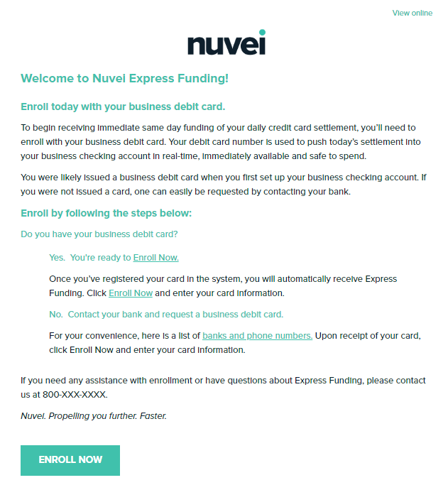
REGISTRATION STEP 1/3: CLICK EMAIL LINK

Slide 14
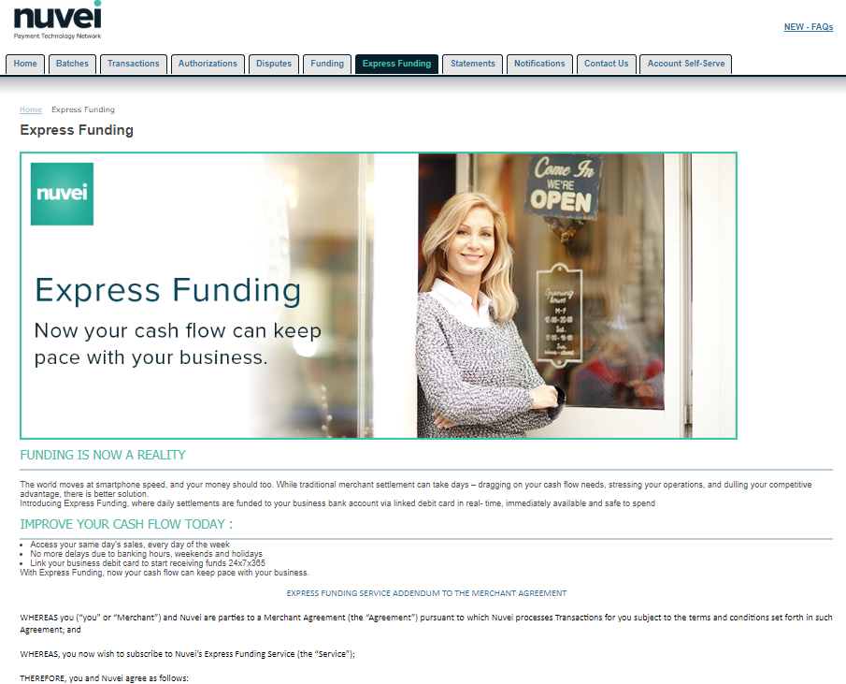
REGISTRATION STEP 2/3: ACCEPT TERMS

Slide 15
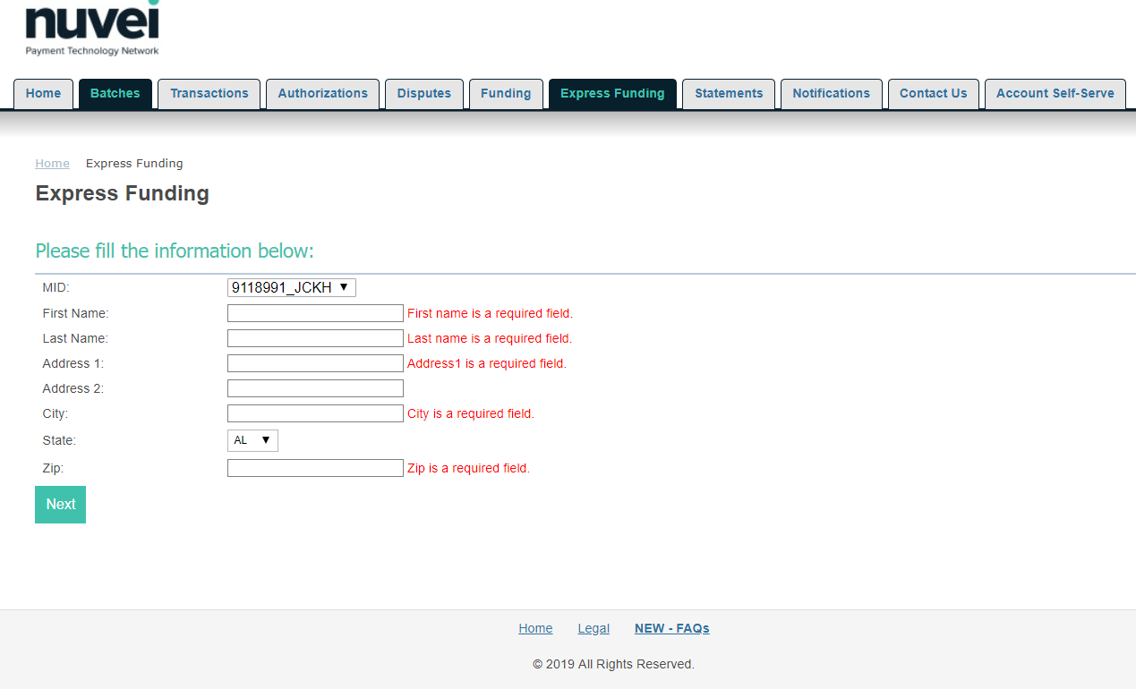
REGISTRATION STEP 3/3: FILL INFORMATION

Slide 16
ACTIVE EXPRESS FUNDING SAMPLE

Slide 17
PAVING
THE WAY
TO GREAT
PARTNERSHIPS
5000 Legacy Drive, Suite 320 Plano, TX 75024, USA
1 877-462-7486
1100 René-Lévesque, 9th Floor, Montréal, QC, H3B 4N4 Canada 1 866-693-2000
nuvei.com

